Slide 1
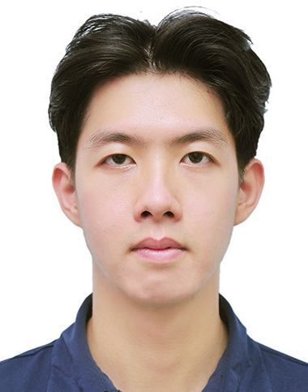



Class-Agnostic Repetitive Action Counting Using Wearable Devices
D. Nguyen, L. Nguyen, Y. Huang, C. Pham, M. Hoai (2025)
IEEE Transactions on Pattern Analysis and Machine Intelligence (TPAMI), 47(6), 1–13.

Slide 2
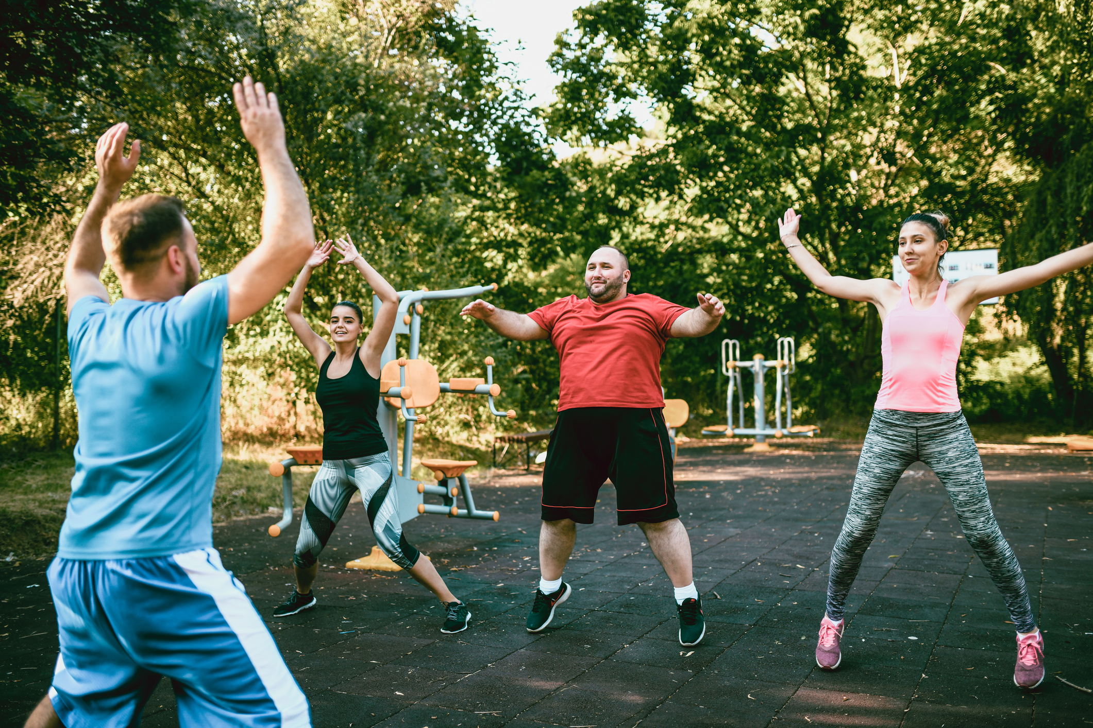
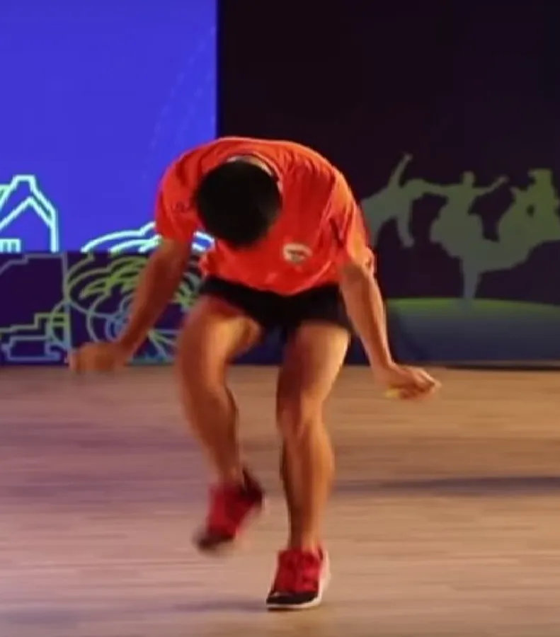
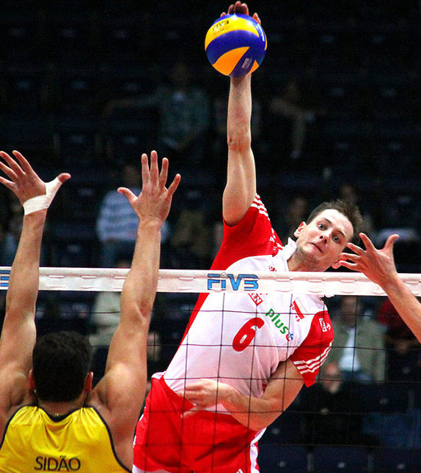
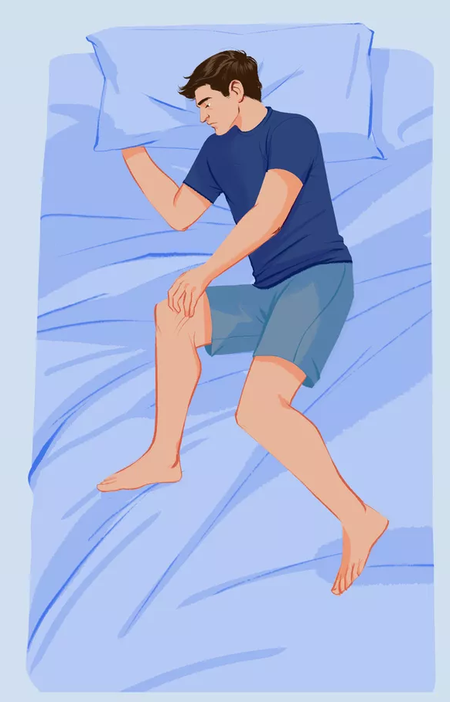
The need for action quantification
Fitness and exercise tracking
Performance evaluation
Injury prevention
(shoulder injury due to too many spikes)
Unconscious action quantification
(e.g., scratching, breathing disturbances & sleep apnea)
(world record for jumping rope
228 times in 30s)

Slide 3
Possible Approaches
Manual enumeration
Automatic methods?
Prone to errors
Remote sensors (e.g., Kinect, camera)
Over or under-counting
Limited measurement capabilities:
  Susceptible to occlusion, out-of-view, & clutter issues
  Inability to capture fine-grained motion
Requires concentration
High computational demand
  Requires powerful machines for processing
  Limits feasibility for real-time feedback
To avoid losing track mid-count
Challenging practical deployment
  Difficult for continuous monitoring
  Raises privacy concerns
Requires duplicate effort
Wearable sensors (e.g., Smartwatch)
To verify doubtful results
Reliable motion capture
Low computational demand
Practical and privacy-friendly

Slide 4
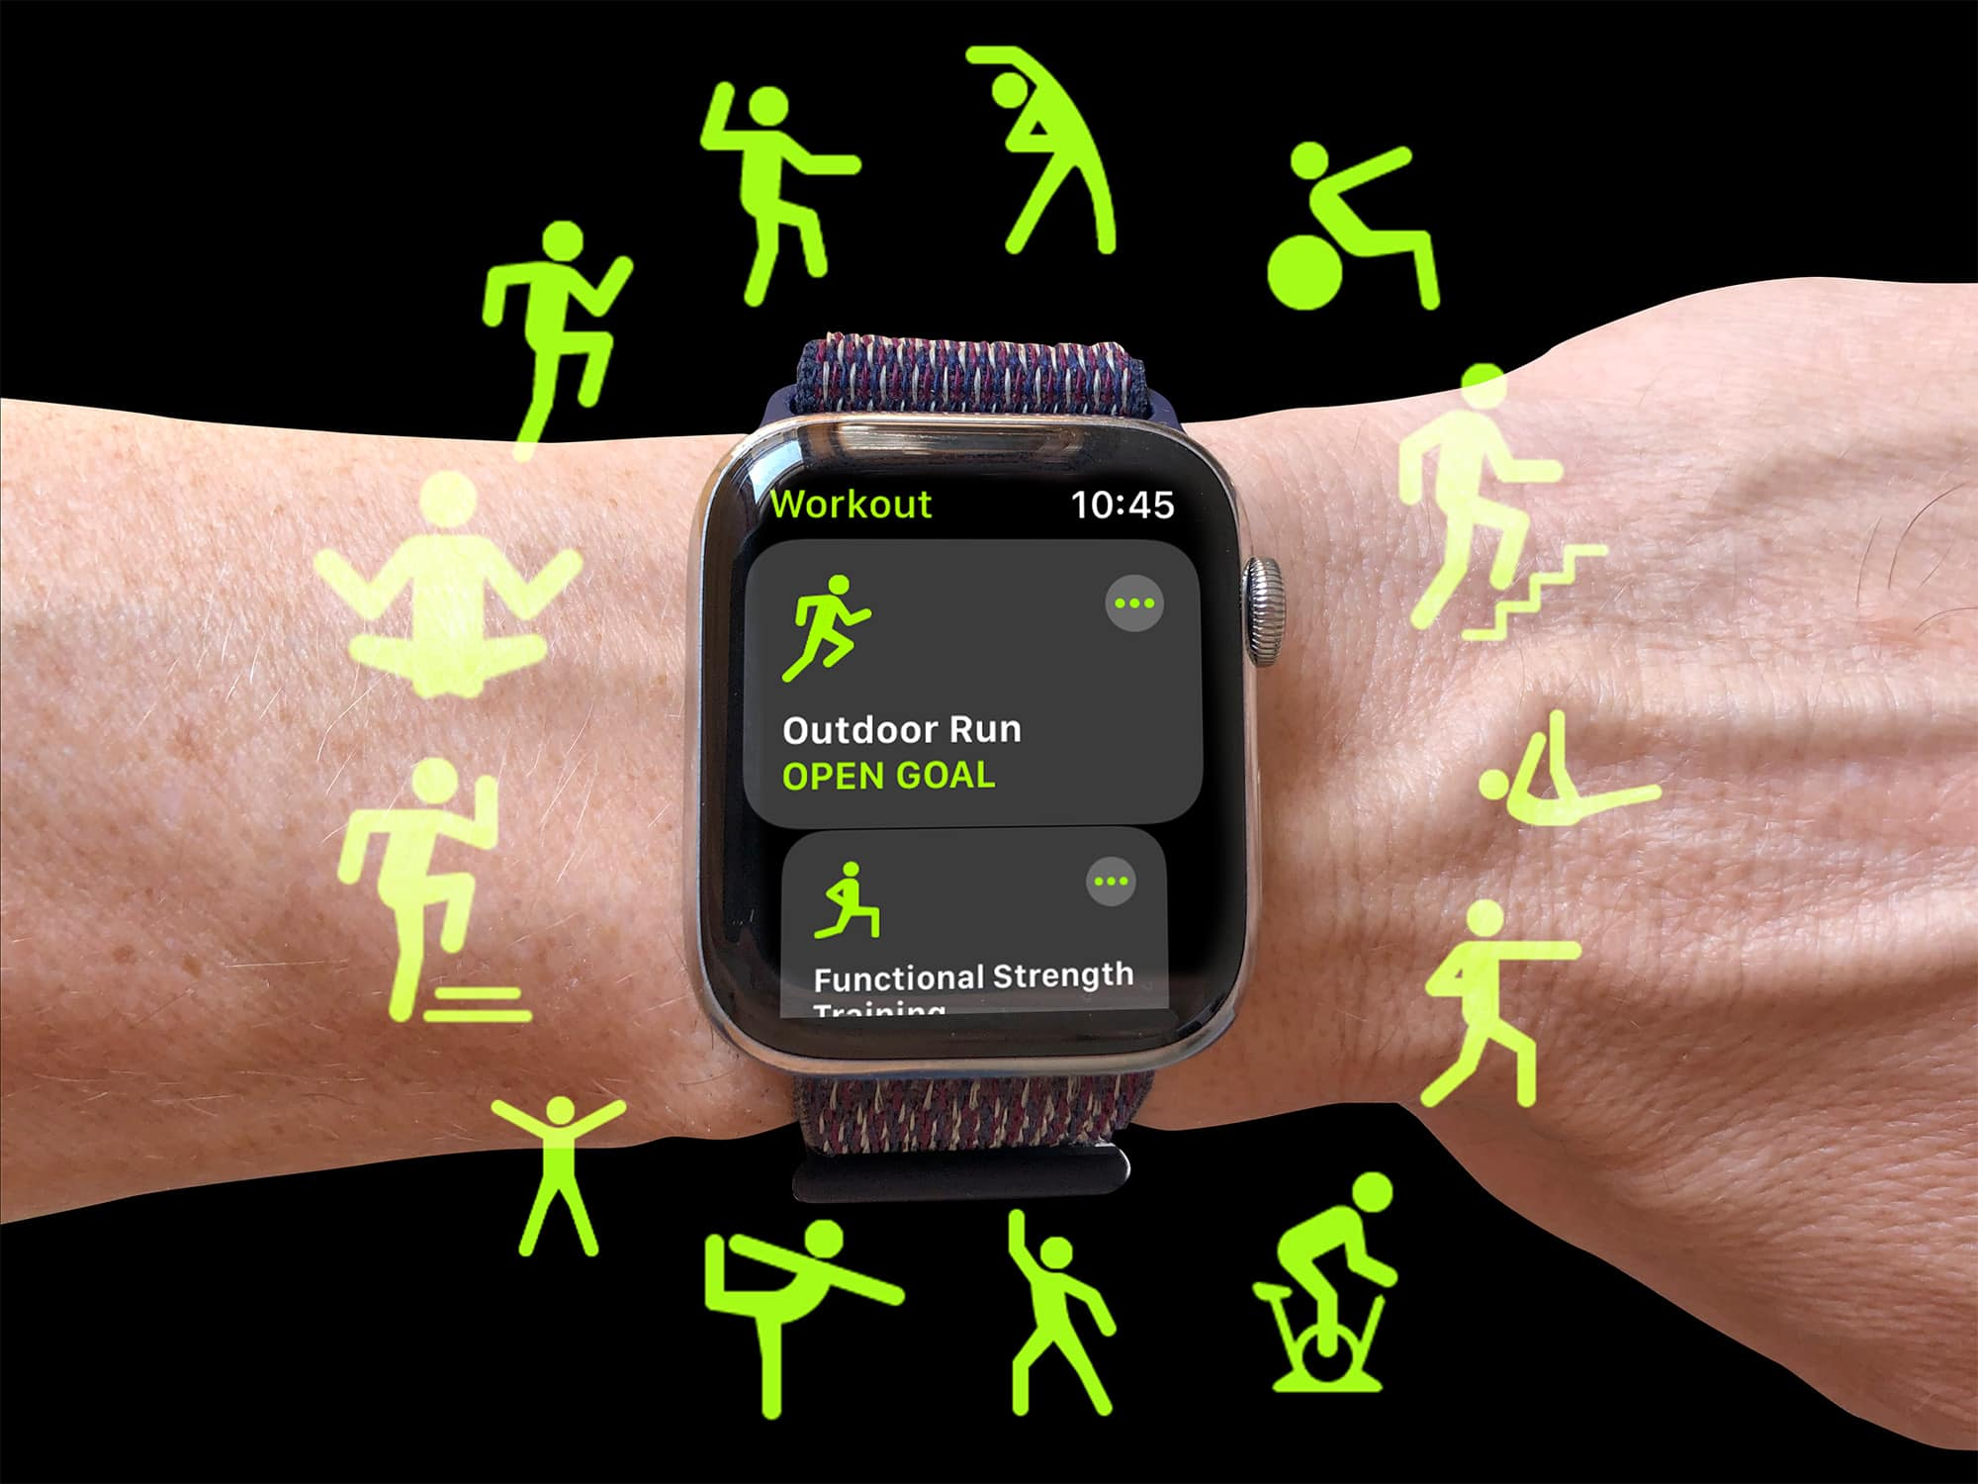
Wearable Sensors

Slide 5
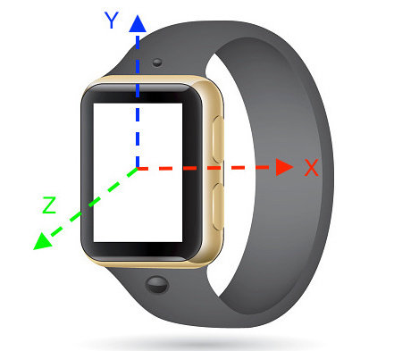
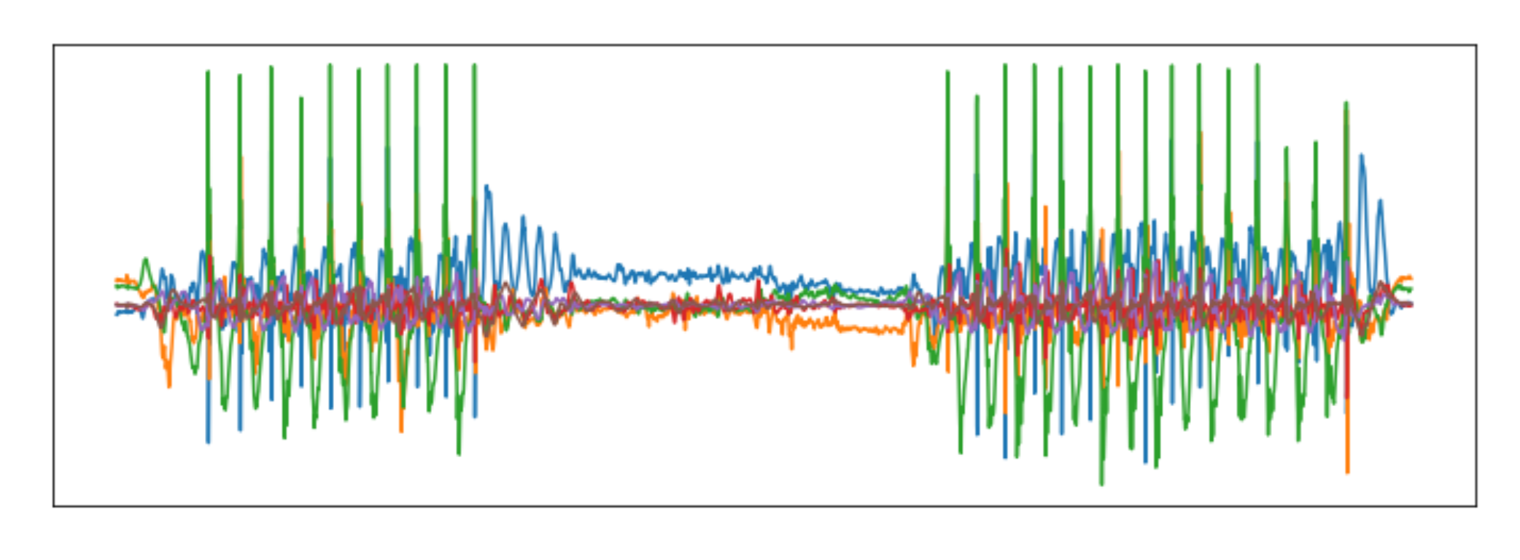
Inertial Measurement Unit (IMU) Data
6-dimensional time series:
3 values from an accelerometer indicating the linear rate of change in velocity of an object relative to a local inertial reference frame
3 values from a gyroscope indicating the rate of rotation about each axis

Slide 6
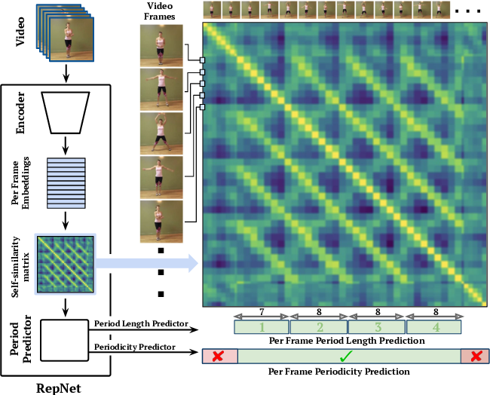
Previous Research Works
Primarily designed for specialized actions, e.g., walking steps
Limited research on general action counting
Recofit [1]: a three-module framework for segmentation, classification, and repetition counting
Only for predefined action classes
Soro et al. [2] propose a two-stage deep learning framework for recognition-then-counting
No prior work on class-agnostic counting for IMU data
RepNet [3] and TransRAC [4], state-of-art methods class-agnostic counting methods for video, do not work well for IMU data
[3] RepNet (CVPR 2020)
[1] Dan et al. Recofit: using a wearable sensor to find, recognize, and count repetitive exercises. In CHI 2014.
[2] Soro et al. Recognition and repetition counting for complex physical exercises with deep learning. In Sensors 2019
[3] Dwibedi et al. Counting out time: Class agnostic video repetition counting in the wild. In CVPR 2020
[4] Huazhang et al. Transrac: Encoding multi-scale temporal correlation with transformers for repetitive action counting. In CVPR 2022

Slide 7
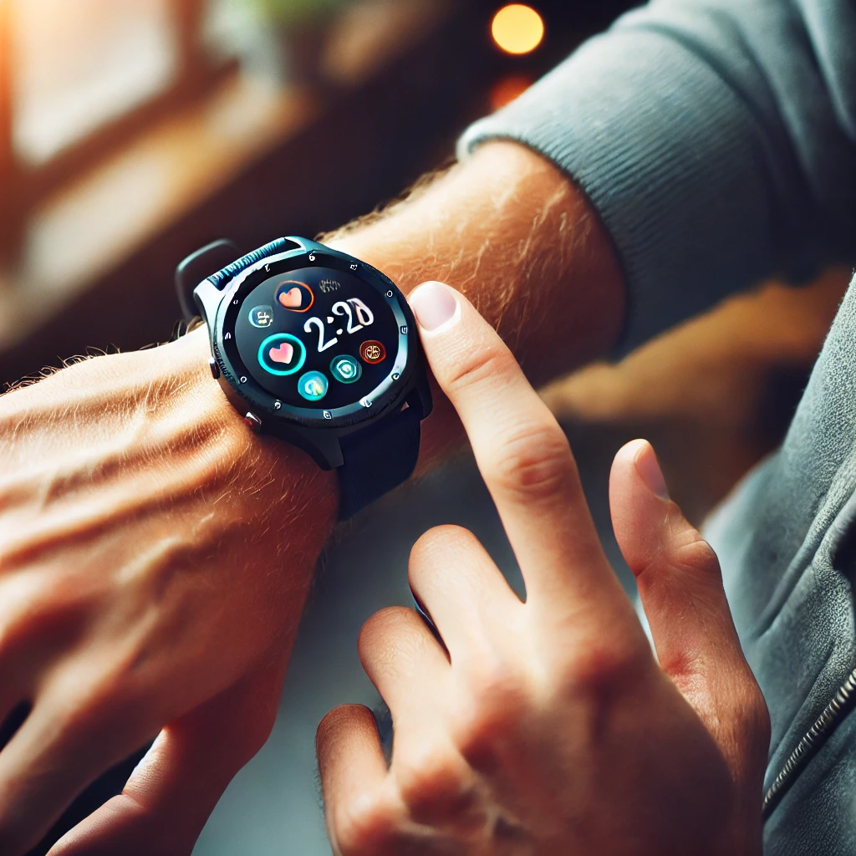

Enable the user to count whatever they want to count
1. Create an intuitive method for users to define target actions with a few exemplars

Slide 8
Enable the user to count whatever they want to count
1. Create an intuitive method for users to define target actions with a few exemplars
2. Count ALL instances of target actions defined by a few exemplars

Slide 9
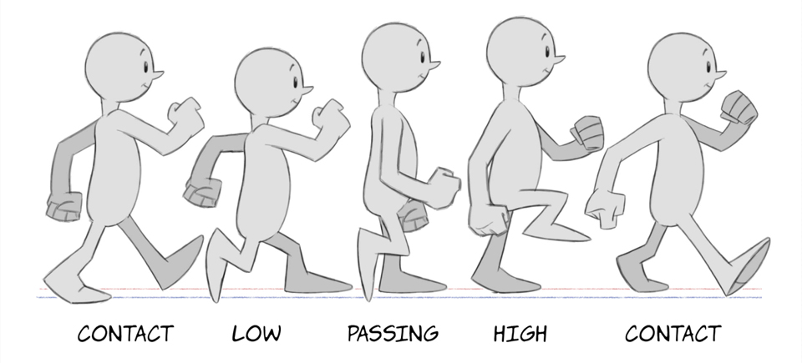
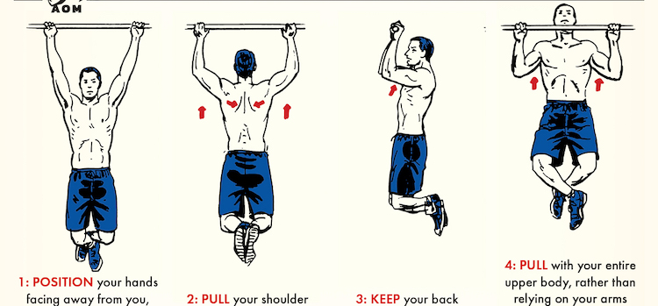
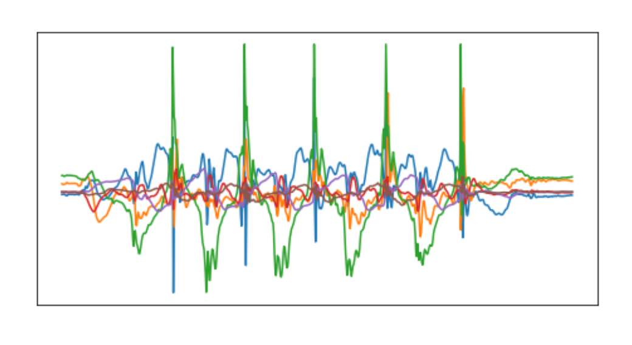
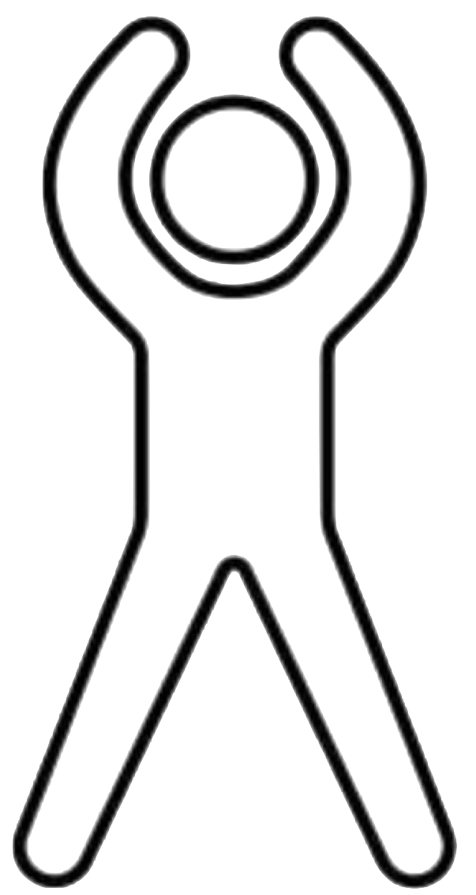
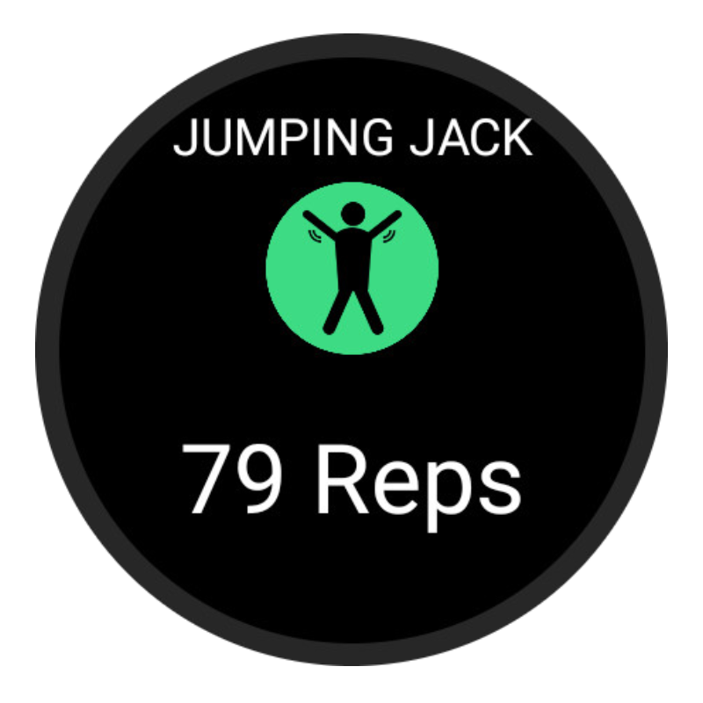
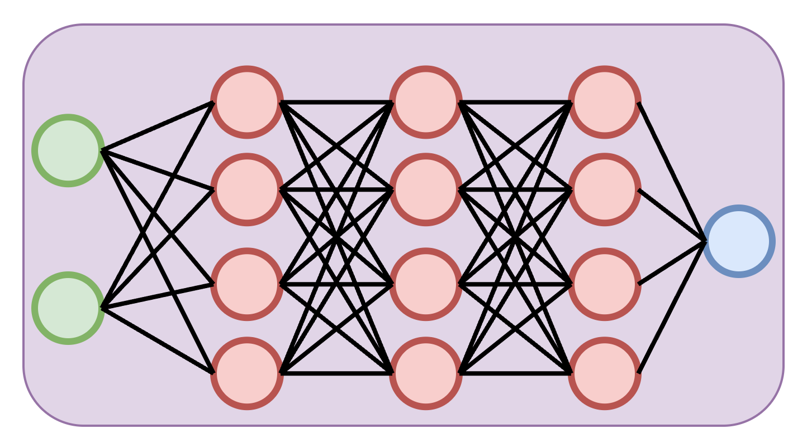
Main Idea
#1
#2
#3
#4
#5
P₁, P₂,…, P_{k}, P₁, P₂,…, P_{k}, P₁, P₂,…, P_{k}, P₁, P₂,…, P_{k}, P₁, P₂,…, P_{k}
Exemplar
count
5
Rhythm, Patterns, and Phases
Few-shot learning
Exemplar
sequence

Slide 10
Processing Pipeline – Learning
Connectionist temporal classification (CTC) loss
Exemplar count: R
Alignment loss
[P₁, P₂,…, P_{k}], … , [P₁, P₂,…, P_{k}]
R blocks of K phases
Train
Feature extraction module
Phase assignment module
v₁ v₂ …v_{n}
f₁, f₂,…, f_{n}
Exemplar sequence
ConvGRU
architecture
Per-window feature embeddings
MLP with K+2 classification heads
(K classes + background + blank)

Slide 11
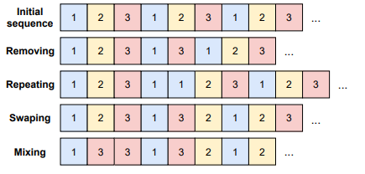
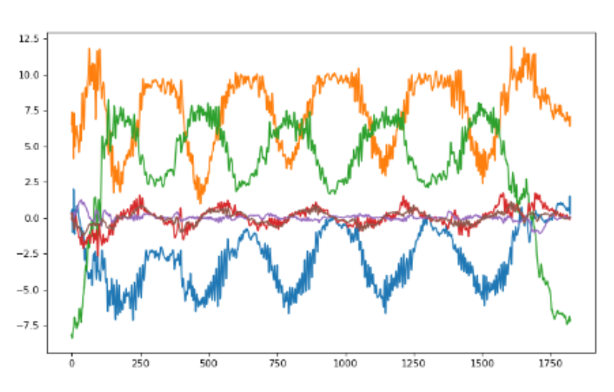
Processing Pipeline – Inferencing
MLP trained with synthetic noisy data
Feature extraction module
Phase assignment module
Count regression module
v₁ v₂ …v_{n}
f₁, f₂,…, f_{n}
Query sequence
Per-window feature embeddings

Slide 12

Processing Pipeline – Learning and Inferencing
Exemplar count: R
Alignment loss
[P₁, P₂,…, P_{k}], … , [P₁, P₂,…, P_{k}]
R blocks of K phases
Train
Feature extraction module
Phase assignment module
Count regression module
v₁ v₂ …v_{n}
f₁, f₂,…, f_{n}
Exemplar/Query
sequence
Per-window feature embeddings
Learning & inferencing
Learning only
Inferencing only
CaRaCount: Class-Agnostic Repetitive Action Counter

Slide 13
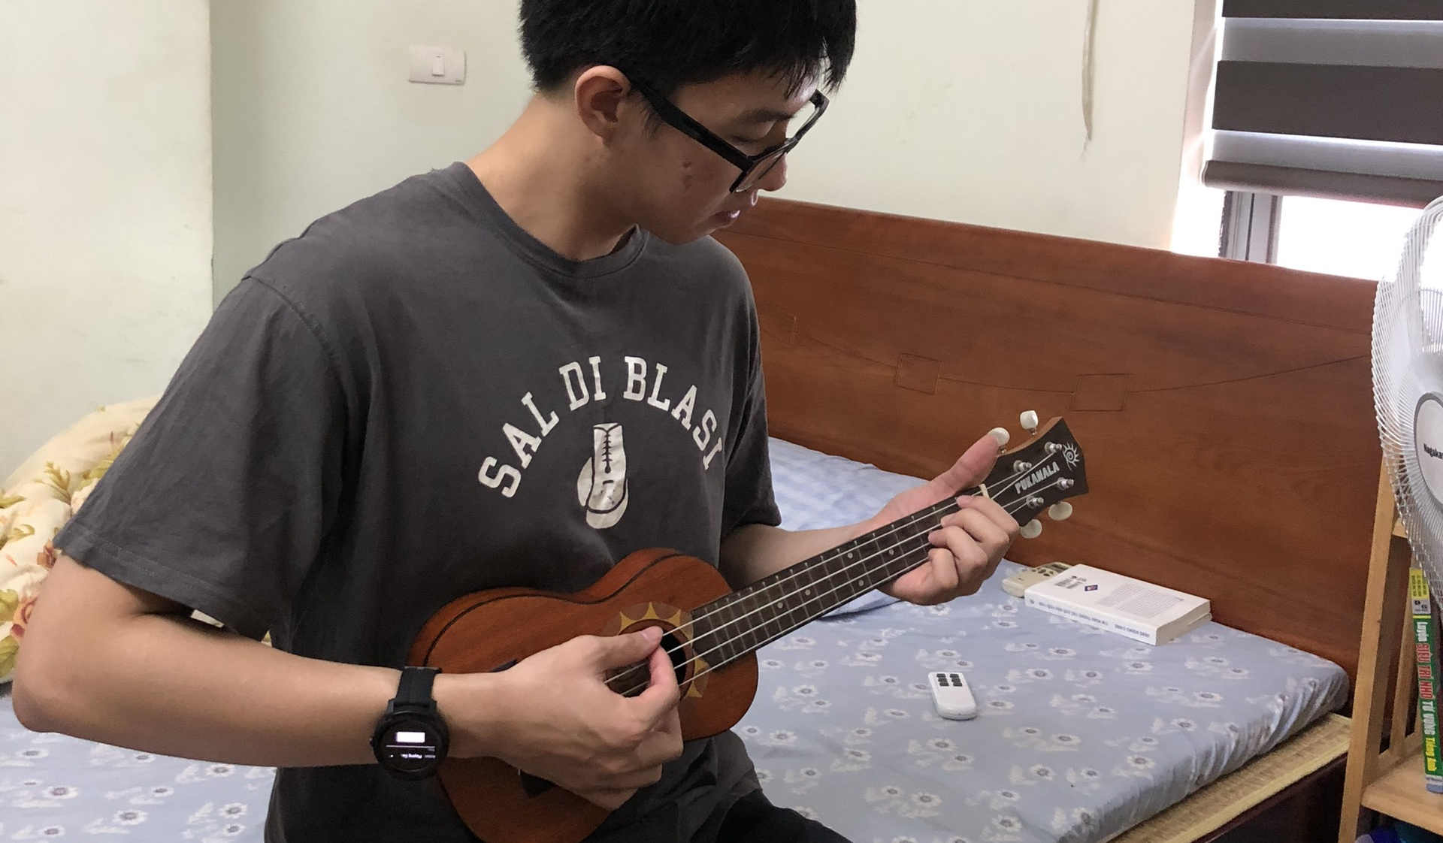
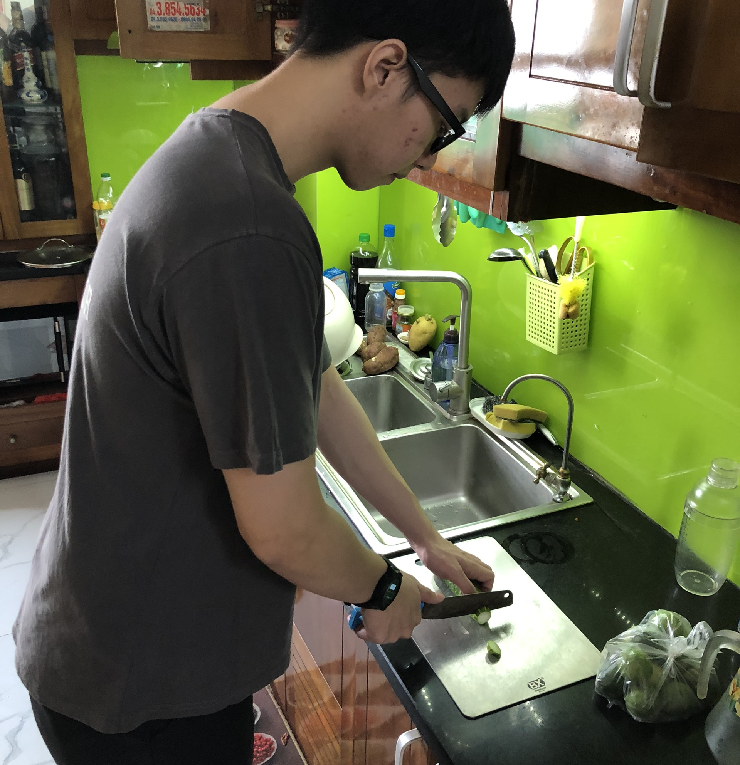
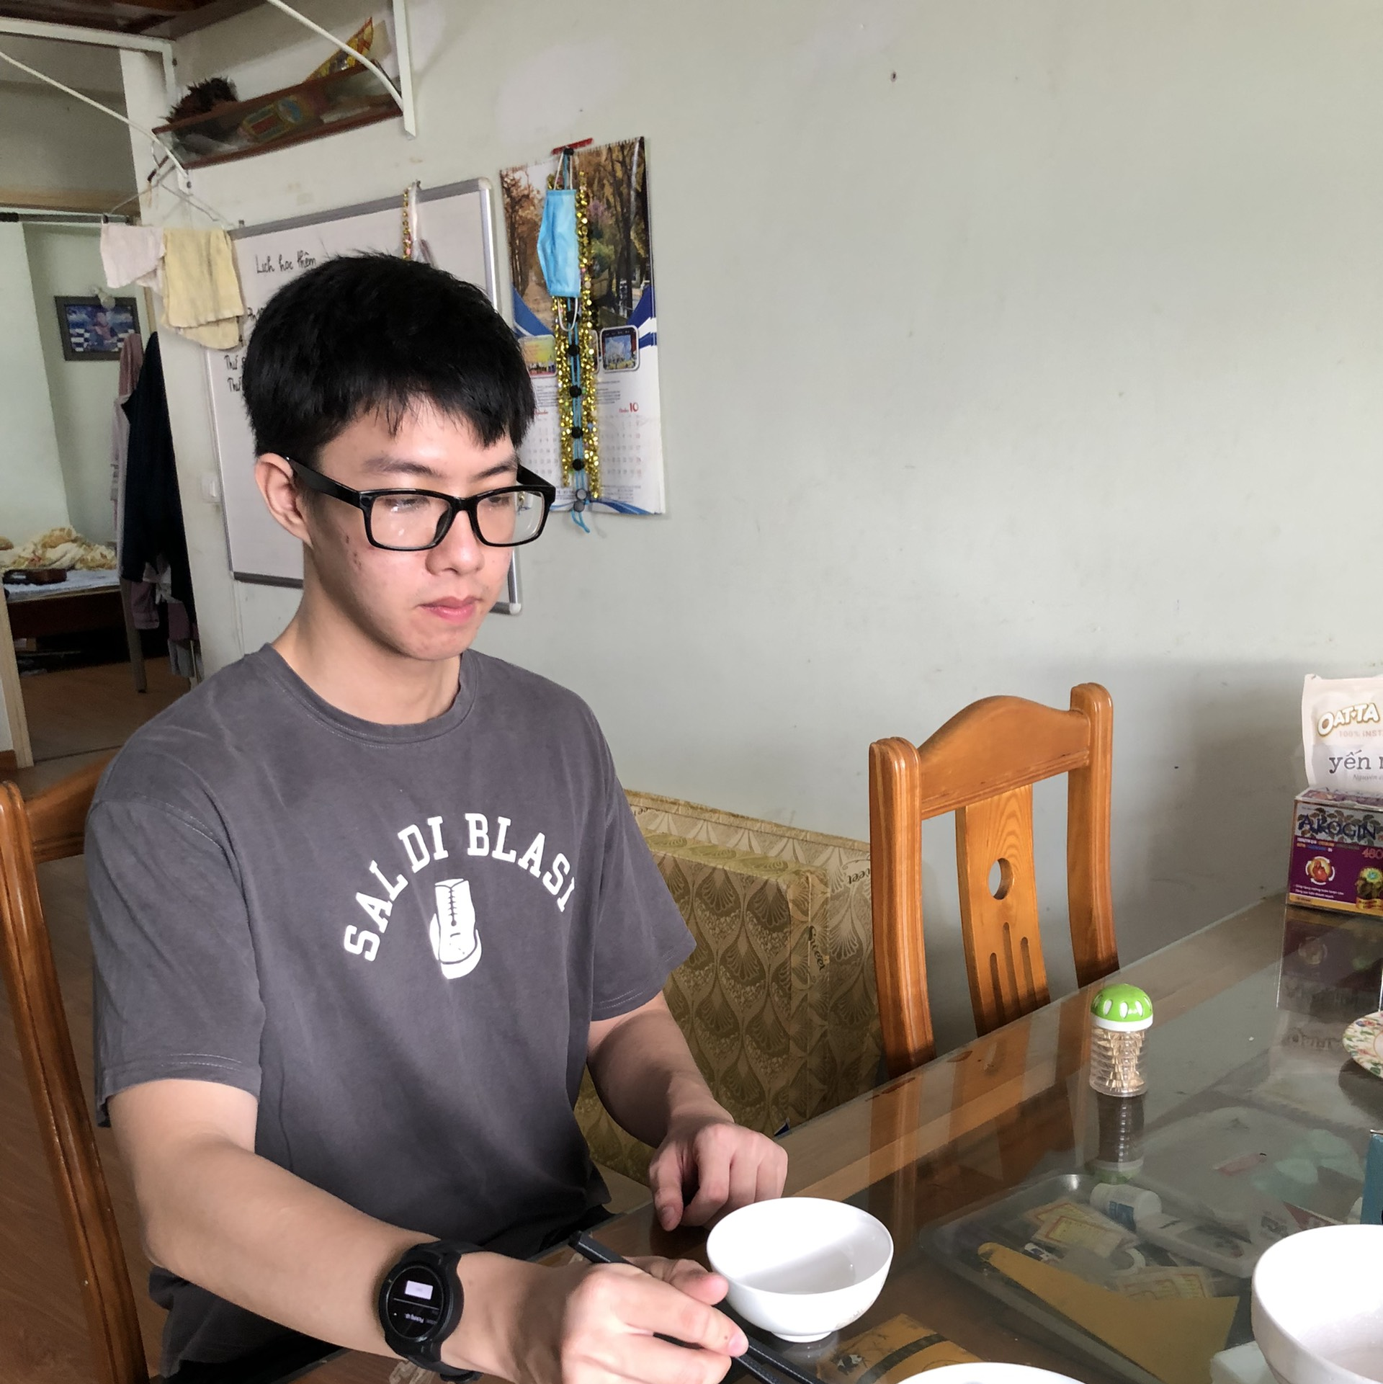
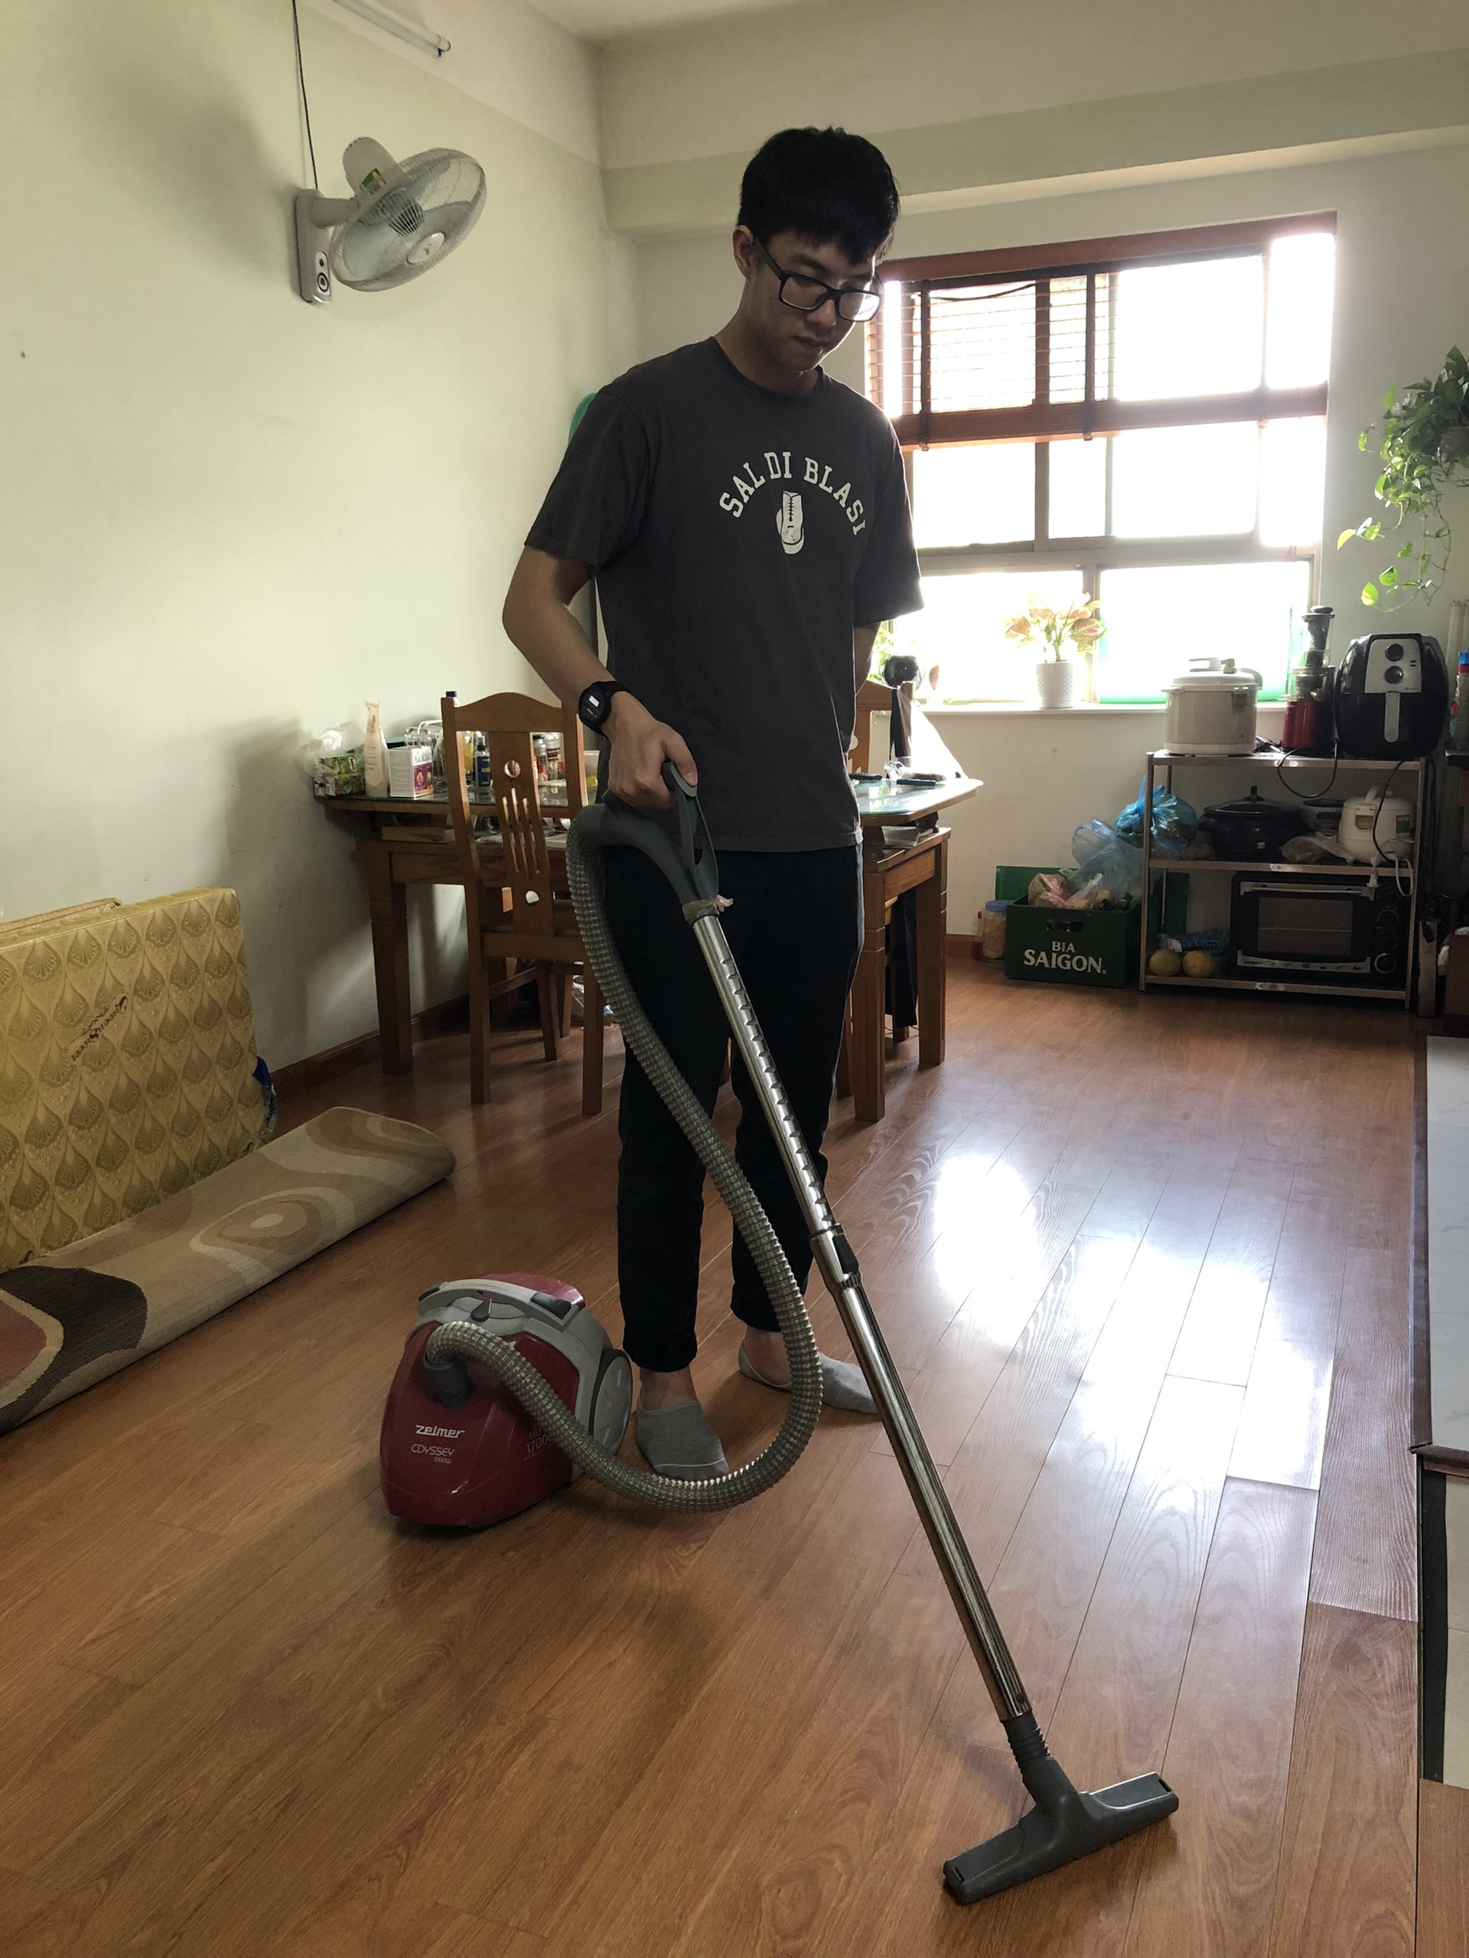
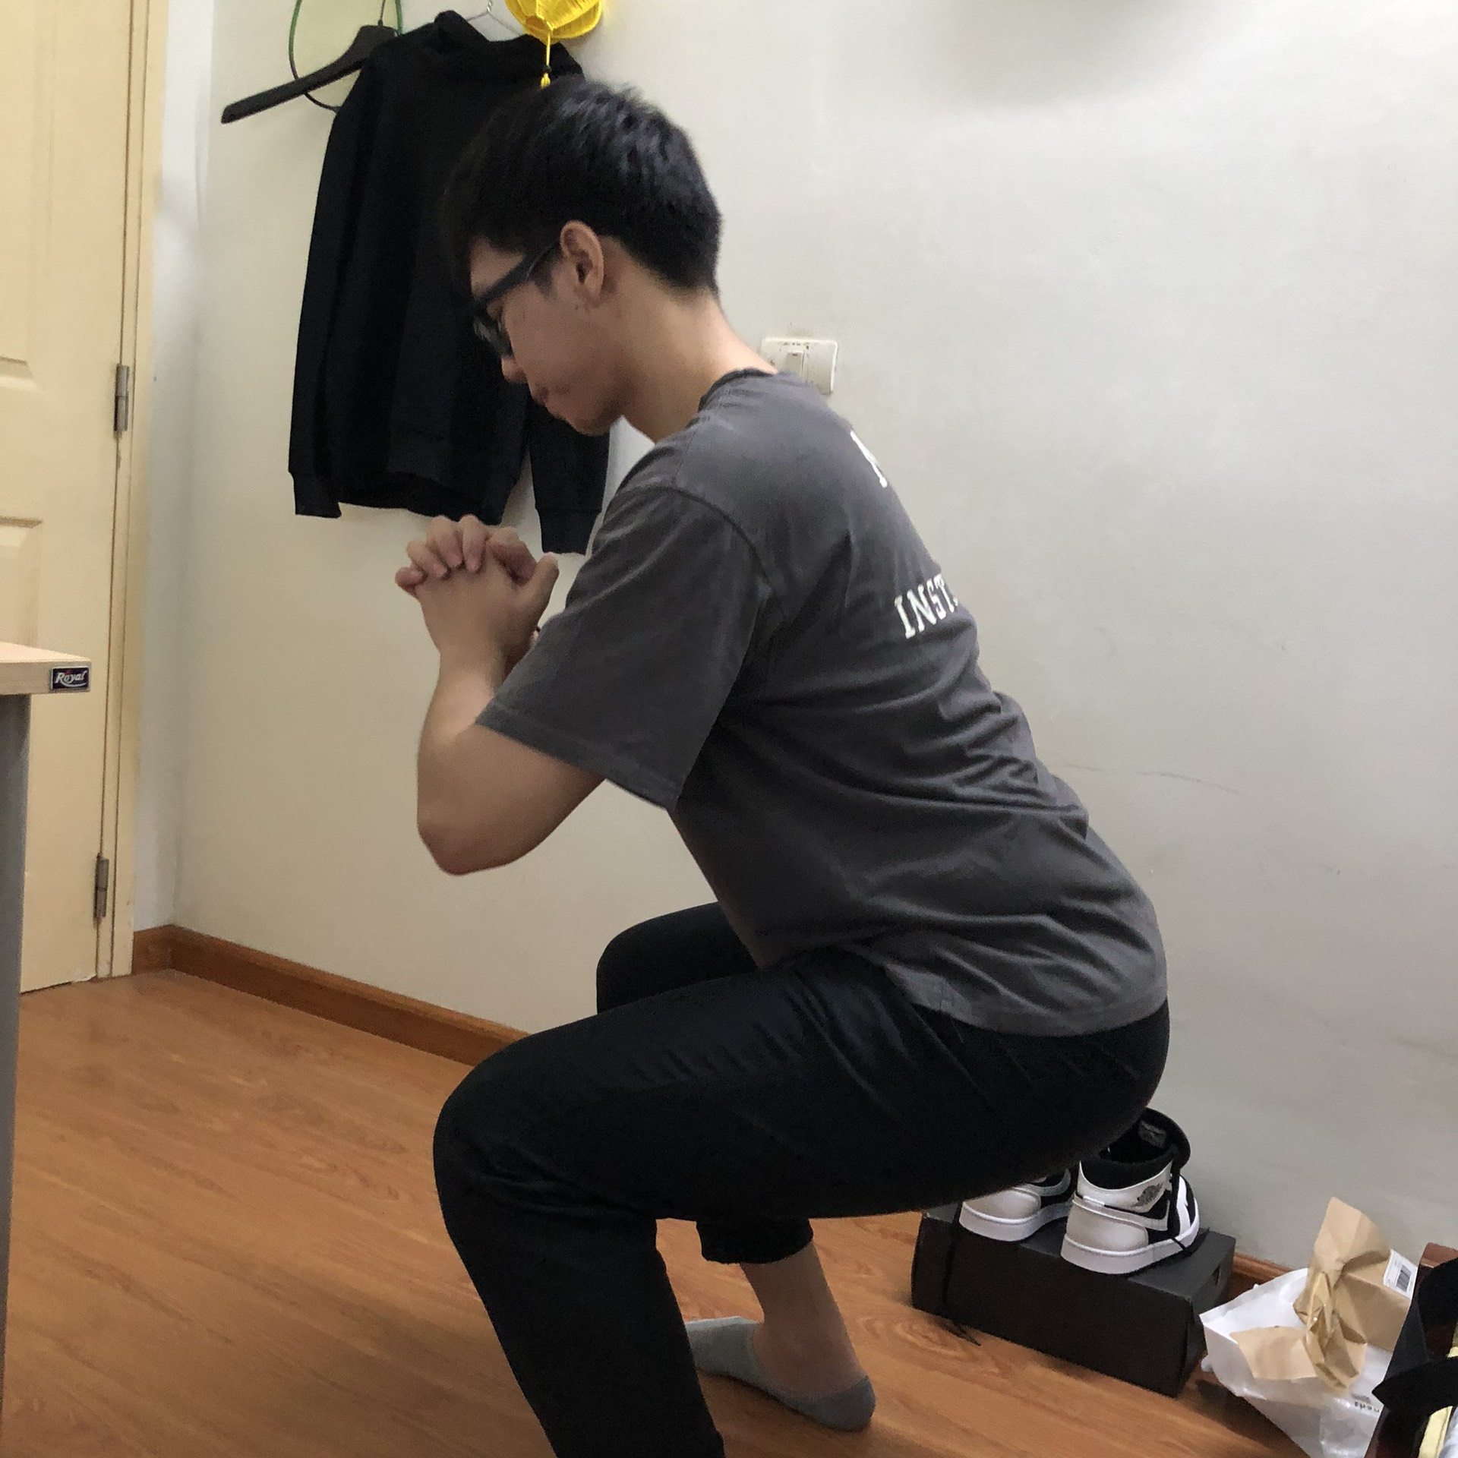
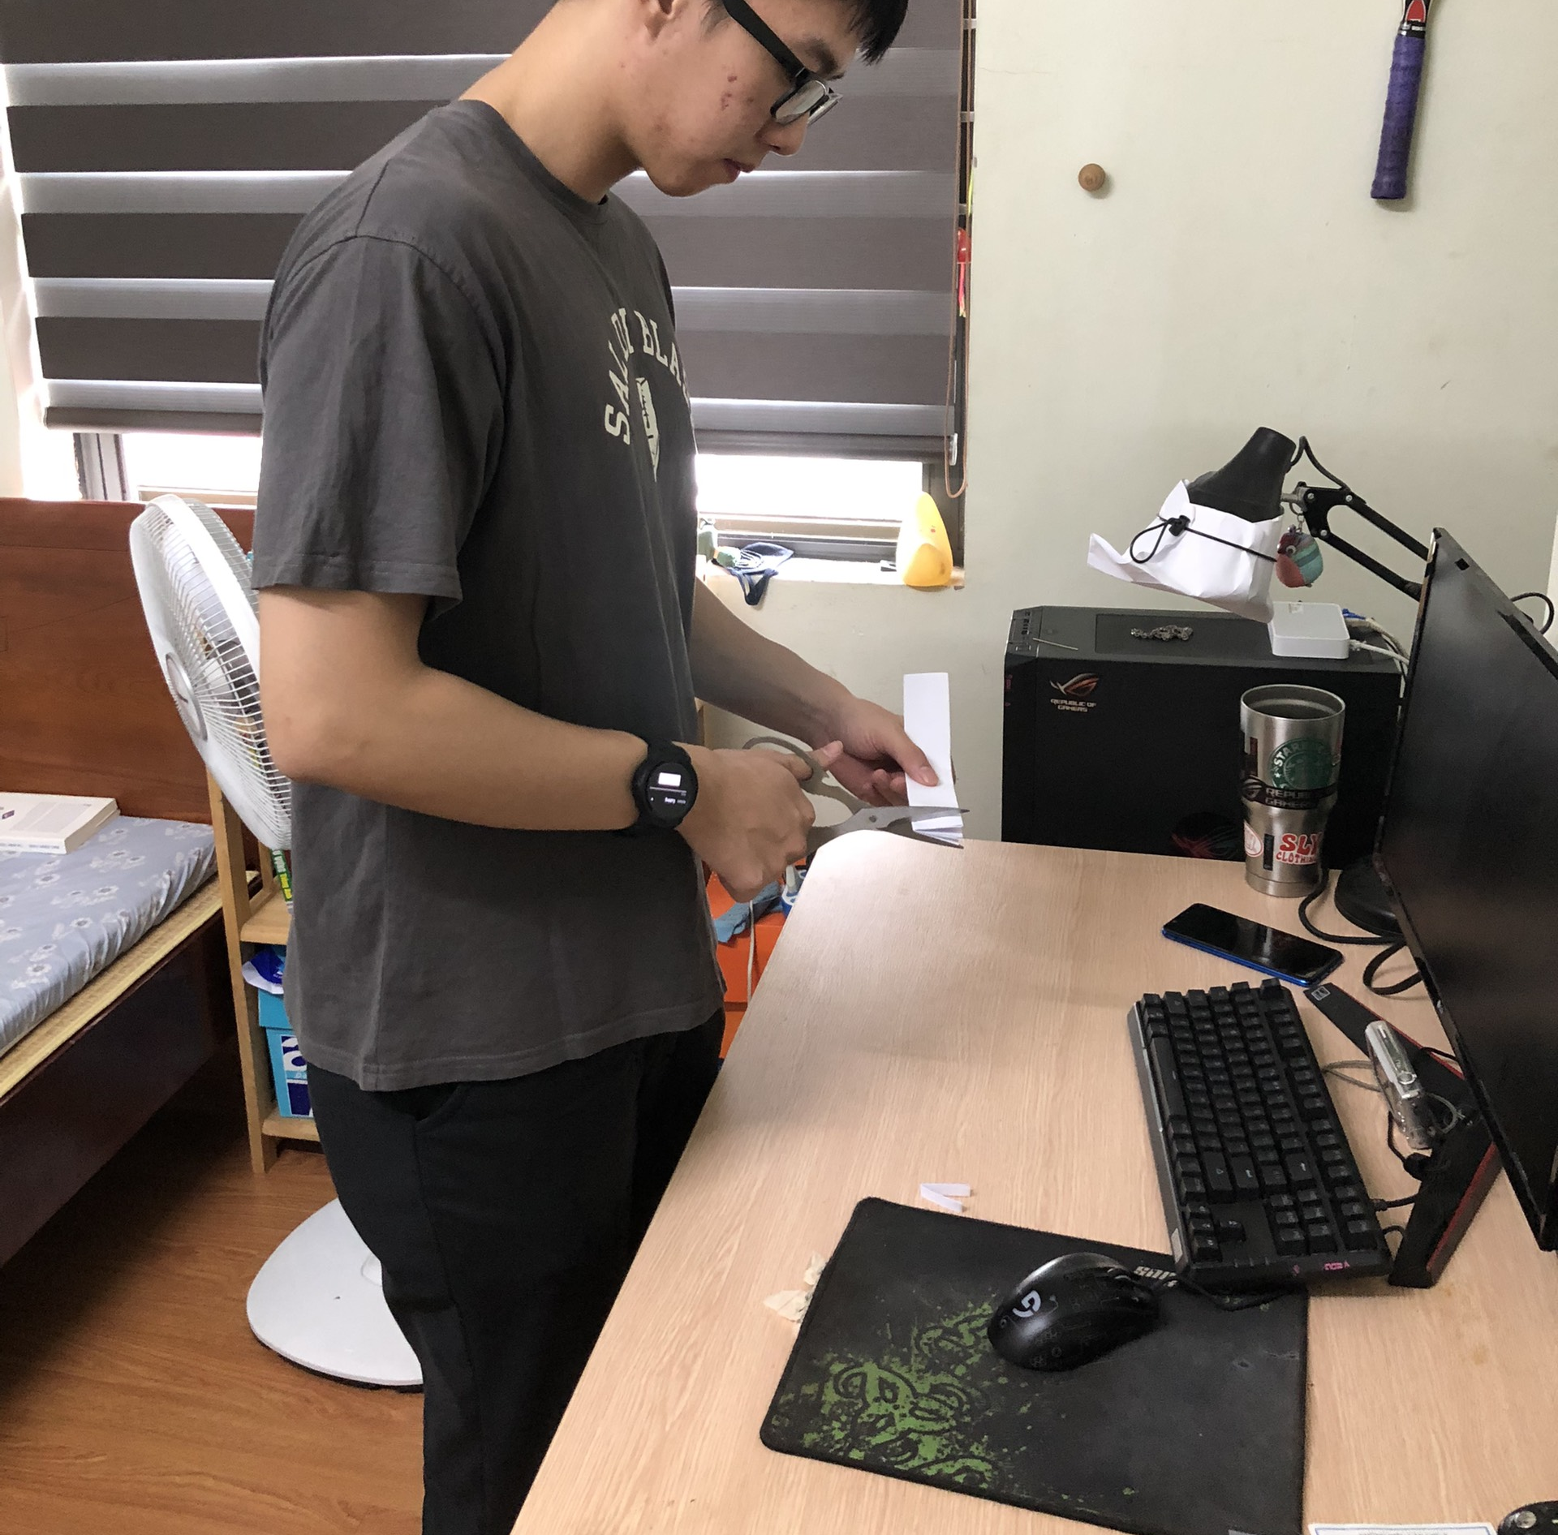
CaRa Dataset

Slide 14
CaRa Dataset
1700 sequences, 36000 repetitions, 10 subjects
50 activities from 6 broad categories:
  kitchen activities
  Household chores
  Physical exercises
  Factory activities
  Daily routines
Instrument-related activities
Number of repetitions per sample:
Min: 1
Max: 150
Average: 21

Slide 15
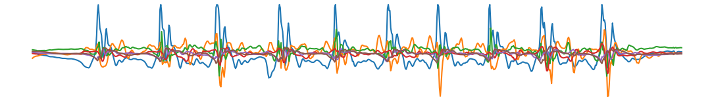
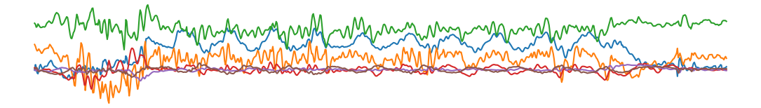
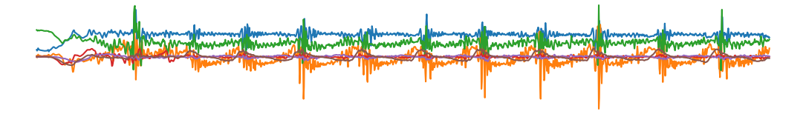
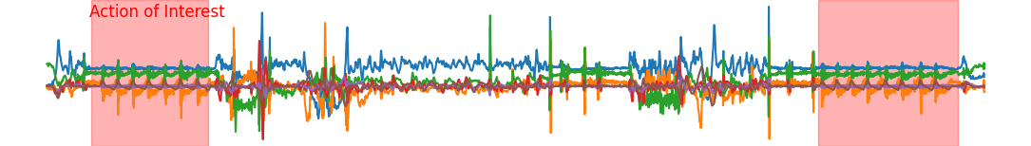
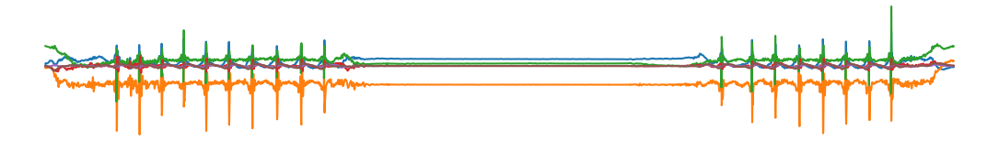
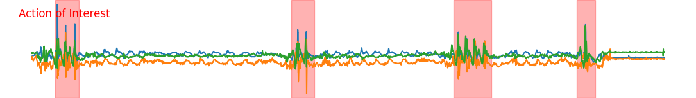
What the Data Look Like
Consistent large peaks
Intraclass variation in timing and patterns
Contiguous actions of interest
Not having the largest magnitude
Non-contiguous but dominant
Non-contiguous, non-dominant

Slide 16
Comparison with other Datasets
Dataset | Number of
 | Super-classes | Classes | Samples | Repetitions | Max repetitions
CaRa | 6 | 50 | 1702 | 35787 | 150
Crossfit | 1 | 10 | 603 | 5470 | 31
Recofit | 1 | 26 | 1348 | 28807 | 100
MM-Fit | 1 | 10 | 616 | 6160 | 14

Slide 17
Quantitative Evaluation Criteria
Mean Absolute Error (MAE):
Root Mean Square Error (RMSE):

Slide 18
Results on the CaRa Dataset
 |  | Dataset
 |  | CaRa |  | Crossfit |  | Recofit |  | MM-Fit
Baseline group | Method | MAE | RMSE | MAE | RMSE | MAE | RMSE | MAE | RMSE
 | CaRaCount (proposed) | 6.26 | 9.78 | 0.13 | 0.42 | 1.48 | 2.97 | 0.32 | 0.68
Simple heuristics | Mean | 18.51 | 24.15 | 7.39 | 7.50 | 11.38 | 12.53 | 4.90 | 4.92
 | Median | 15.74 | 26.37 | 7.03 | 7.15 | 11.36 | 12.52 | 4.90 | 4.94
 | Average time | 13.25 | 20.56 | 2.16 | 2.62 | 1.87 | 3.23 | 4.01 | 5.98
 | Dominant frequency | 13.73 | 21.06 | 3.05 | 3.44 | 3.07 | 4.97 | 5.77 | 7.74
Signal-processing methods | Threshold crossing [41] | 15.76 | 21.60 | 2.35 | 3.69 | 2.65 | 5.08 | 4.97 | 7.54
 | Peak detection [22, 35] | 10.12 | 19.04 | 2.67 | 3.42 | 3.09 | 5.67 | 1.33 | 2.62
Deep-learning methods | Soro et al.[33] | 10.86 | 18.22 | 0.55 | 1.19 | 2.23 | 3.77 | n/a | n/a
 | Basic transformer | 10.70 | 12.80 | 0.89 | 1.04 | 5.60 | 7.46 | 0.99 | 1.27
Video-based methods | RepNet [8] | 10.37 | 12.46 | 0.63 | 0.79 | 5.38 | 7.20 | 0.34 | 0.76
 | TransRAC [14] | 8.42 | 11.53 | 0.71 | 0.85 | 6.54 | 8.64 | 0.39 | 0.77

Slide 19
Results on the CaRa Dataset
 |  | Dataset
 |  | CaRa |  | Crossfit |  | Recofit |  | MM-Fit
Baseline group | Method | MAE | RMSE | MAE | RMSE | MAE | RMSE | MAE | RMSE
 | CaRaCount (proposed) | 6.26 | 9.78 | 0.13 | 0.42 | 1.48 | 2.97 | 0.32 | 0.68
Simple heuristics | Mean | 18.51 | 24.15 | 7.39 | 7.50 | 11.38 | 12.53 | 4.90 | 4.92
 | Median | 15.74 | 26.37 | 7.03 | 7.15 | 11.36 | 12.52 | 4.90 | 4.94
 | Average time | 13.25 | 20.56 | 2.16 | 2.62 | 1.87 | 3.23 | 4.01 | 5.98
 | Dominant frequency | 13.73 | 21.06 | 3.05 | 3.44 | 3.07 | 4.97 | 5.77 | 7.74
Signal-processing methods | Threshold crossing [41] | 15.76 | 21.60 | 2.35 | 3.69 | 2.65 | 5.08 | 4.97 | 7.54
 | Peak detection [22, 35] | 10.12 | 19.04 | 2.67 | 3.42 | 3.09 | 5.67 | 1.33 | 2.62
Deep-learning methods | Soro et al.[33] | 10.86 | 18.22 | 0.55 | 1.19 | 2.23 | 3.77 | n/a | n/a
 | Basic transformer | 10.70 | 12.80 | 0.89 | 1.04 | 5.60 | 7.46 | 0.99 | 1.27
Video-based methods | RepNet [8] | 10.37 | 12.46 | 0.63 | 0.79 | 5.38 | 7.20 | 0.34 | 0.76
 | TransRAC [14] | 8.42 | 11.53 | 0.71 | 0.85 | 6.54 | 8.64 | 0.39 | 0.77
Notes:
Average time: estimating the average time to perform a single rep from the exemplar sequence and then utilizing it to compute the final count in the query sequence
Frequency: estimating the dominant frequency of the action of interest from the exemplar sequence and then utilizing it to compute the final count in the query sequence.
Threshold cross: Zelman et al.[41] set a threshold line positioned at two-thirds of the range between the minimum and maximum values. When the signal goes from below to above the threshold line, the count will be increased by one.
Peak detection: Morris et al.[22] and David et al.[35] use similar approaches to tackle to the counting task. They first computed a set of candidate peaks from the signal and then utilized autocorrelation as well as amplitude statistics to eliminate unqualified candidates.

Slide 20
Results on the CaRa Dataset
 |  | Dataset
 |  | CaRa |  | Crossfit |  | Recofit |  | MM-Fit
Baseline group | Method | MAE | RMSE | MAE | RMSE | MAE | RMSE | MAE | RMSE
 | CaRaCount (proposed) | 6.26 | 9.78 | 0.13 | 0.42 | 1.48 | 2.97 | 0.32 | 0.68
Simple heuristics | Mean | 18.51 | 24.15 | 7.39 | 7.50 | 11.38 | 12.53 | 4.90 | 4.92
 | Median | 15.74 | 26.37 | 7.03 | 7.15 | 11.36 | 12.52 | 4.90 | 4.94
 | Average time | 13.25 | 20.56 | 2.16 | 2.62 | 1.87 | 3.23 | 4.01 | 5.98
 | Dominant frequency | 13.73 | 21.06 | 3.05 | 3.44 | 3.07 | 4.97 | 5.77 | 7.74
Signal-processing methods | Threshold crossing [41] | 15.76 | 21.60 | 2.35 | 3.69 | 2.65 | 5.08 | 4.97 | 7.54
 | Peak detection [22, 35] | 10.12 | 19.04 | 2.67 | 3.42 | 3.09 | 5.67 | 1.33 | 2.62
Deep-learning methods | Soro et al.[33] | 10.86 | 18.22 | 0.55 | 1.19 | 2.23 | 3.77 | n/a | n/a
 | Basic transformer | 10.70 | 12.80 | 0.89 | 1.04 | 5.60 | 7.46 | 0.99 | 1.27
Video-based methods | RepNet [8] | 10.37 | 12.46 | 0.63 | 0.79 | 5.38 | 7.20 | 0.34 | 0.76
 | TransRAC [14] | 8.42 | 11.53 | 0.71 | 0.85 | 6.54 | 8.64 | 0.39 | 0.77

Slide 21
Results on Multiple Datasets
 |  | Dataset
 |  | CaRa |  | Crossfit |  | Recofit |  | MM-Fit
Baseline group | Method | MAE | RMSE | MAE | RMSE | MAE | RMSE | MAE | RMSE
 | CaRaCount (proposed) | 6.26 | 9.78 | 0.13 | 0.42 | 1.48 | 2.97 | 0.32 | 0.68
Simple heuristics | Mean | 18.51 | 24.15 | 7.39 | 7.50 | 11.38 | 12.53 | 4.90 | 4.92
 | Median | 15.74 | 26.37 | 7.03 | 7.15 | 11.36 | 12.52 | 4.90 | 4.94
 | Average time | 13.25 | 20.56 | 2.16 | 2.62 | 1.87 | 3.23 | 4.01 | 5.98
 | Dominant frequency | 13.73 | 21.06 | 3.05 | 3.44 | 3.07 | 4.97 | 5.77 | 7.74
Signal-processing methods | Threshold crossing [41] | 15.76 | 21.60 | 2.35 | 3.69 | 2.65 | 5.08 | 4.97 | 7.54
 | Peak detection [22, 35] | 10.12 | 19.04 | 2.67 | 3.42 | 3.09 | 5.67 | 1.33 | 2.62
Deep-learning methods | Soro et al.[33] | 10.86 | 18.22 | 0.55 | 1.19 | 2.23 | 3.77 | n/a | n/a
 | Basic transformer | 10.70 | 12.80 | 0.89 | 1.04 | 5.60 | 7.46 | 0.99 | 1.27
Video-based methods | RepNet [8] | 10.37 | 12.46 | 0.63 | 0.79 | 5.38 | 7.20 | 0.34 | 0.76
 | TransRAC [14] | 8.42 | 11.53 | 0.71 | 0.85 | 6.54 | 8.64 | 0.39 | 0.77

Slide 22
Results on Multiple Datasets
 |  | Dataset
 |  | CaRa |  | Crossfit |  | Recofit |  | MM-Fit
Baseline group | Method | MAE | RMSE | MAE | RMSE | MAE | RMSE | MAE | RMSE
 | CaRaCount (proposed) | 6.26 | 9.78 | 0.13 | 0.42 | 1.48 | 2.97 | 0.32 | 0.68
Simple heuristics | Mean | 18.51 | 24.15 | 7.39 | 7.50 | 11.38 | 12.53 | 4.90 | 4.92
 | Median | 15.74 | 26.37 | 7.03 | 7.15 | 11.36 | 12.52 | 4.90 | 4.94
 | Average time | 13.25 | 20.56 | 2.16 | 2.62 | 1.87 | 3.23 | 4.01 | 5.98
 | Dominant frequency | 13.73 | 21.06 | 3.05 | 3.44 | 3.07 | 4.97 | 5.77 | 7.74
Signal-processing methods | Threshold crossing [41] | 15.76 | 21.60 | 2.35 | 3.69 | 2.65 | 5.08 | 4.97 | 7.54
 | Peak detection [22, 35] | 10.12 | 19.04 | 2.67 | 3.42 | 3.09 | 5.67 | 1.33 | 2.62
Deep-learning methods | Soro et al.[33] | 10.86 | 18.22 | 0.55 | 1.19 | 2.23 | 3.77 | n/a | n/a
 | Basic transformer | 10.70 | 12.80 | 0.89 | 1.04 | 5.60 | 7.46 | 0.99 | 1.27
Video-based methods | RepNet [8] | 10.37 | 12.46 | 0.63 | 0.79 | 5.38 | 7.20 | 0.34 | 0.76
 | TransRAC [14] | 8.42 | 11.53 | 0.71 | 0.85 | 6.54 | 8.64 | 0.39 | 0.77

Slide 23
Results – Phase Assignment
CaRaCount considers the transition from Phase 4 to Phase 1 as the action boundary
CaRaCount
Manual label

Slide 24
Results – Action Boundary Detection
CaRaCount considers the transition from Phase 4 to Phase 1 as the action boundary
CaRaCount
Manual label

Slide 25
Qualitative Results
Ground-truth: 50
Predicted: 49
Ground-truth: 20
Predicted: 20
Ground-truth: 30
Predicted: 30

Slide 26
Qualitative Results – Failure Cases
Ground-truth: 12
Predicted: 30
Ground-truth: 40
Predicted: 22

Slide 27
Ablation Study – Number of Phases
Number of phases | MAE | RMSE
2 | 10.79 | 15.54
3 | 9.01 | 13.62
4 | 6.26 | 9.78
5 | 6.43 | 9.61

Slide 28
Thank you

